Slide 1
Peer Review Management System (PRMS)
“The New Web Tool”

Slide 2
What is Different
Reviewer Notifications for every reviewer assignment will go out to reviewers
Reviewer comments at the top screen and scores moved to bottom
Reviewer can answer questions on the review form without required comments
Scores are no longer numerical. Papers will now say accepted or rejected.
Submission status and review status will appear as separate columns
Authors will be listed on the organizer tool grid
Reports will include additional info, like removed or withdrawn submissions
TPC and Conference Chairs have top level access to organize the sessions

Slide 3
Schedule
Process has many steps that must be done in series
All deadlines close at 11:59 pm ET
Reviewers will lose access to submissions at this time
If you are late or incomplete to a deadline, it puts untenable pressure on the downstream steps
Deadlines are completion dates, not start dates
Start early!
SC/TO/SO all need to check, monitor, support, and push along progress and quality throughout their span of responsibilities
Send reminders to start tasks and meet deadlines
Check status and address problems regularly

Slide 4
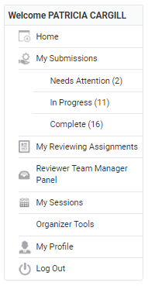
Overview of Navigation
My submissions
Authors
My reviewing assignments Reviewer – review draft papers
My sessions
SC/TO – go into session, pull abstracts into sessions
SC/TO – assign session organizer, change title, description
SO – add co-chair, change title, description
SO, TO, or SC – reorder papers, remove papers, add to other sessions
Organizer tools
All organizers - shows big list of all abstracts and papers
All organizers – can export excel file showing all papers
SO – assign reviewers, view reviews, make paper decision
Note: Some navigation items will not appear until after a submission has been received.

Slide 5
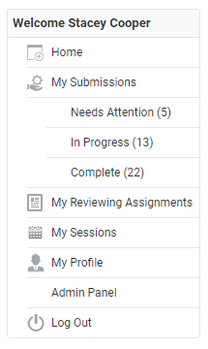
You will need to assign papers to sessions in order to assign reviewers and review papers.
Note: Staff will create sessions for all tracks and topics.

Slide 6
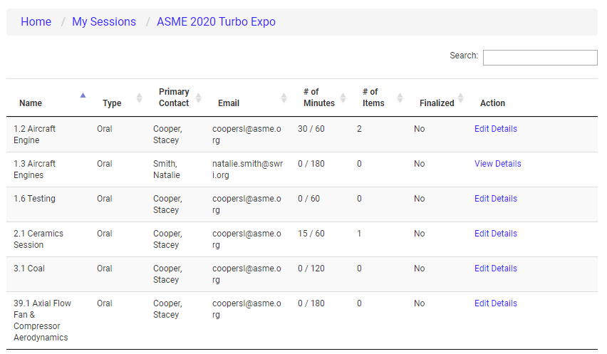
The list of sessions you have been assigned will be displayed on the next screen. Click on the “Edit Details” link to start organizing your session.

Slide 7
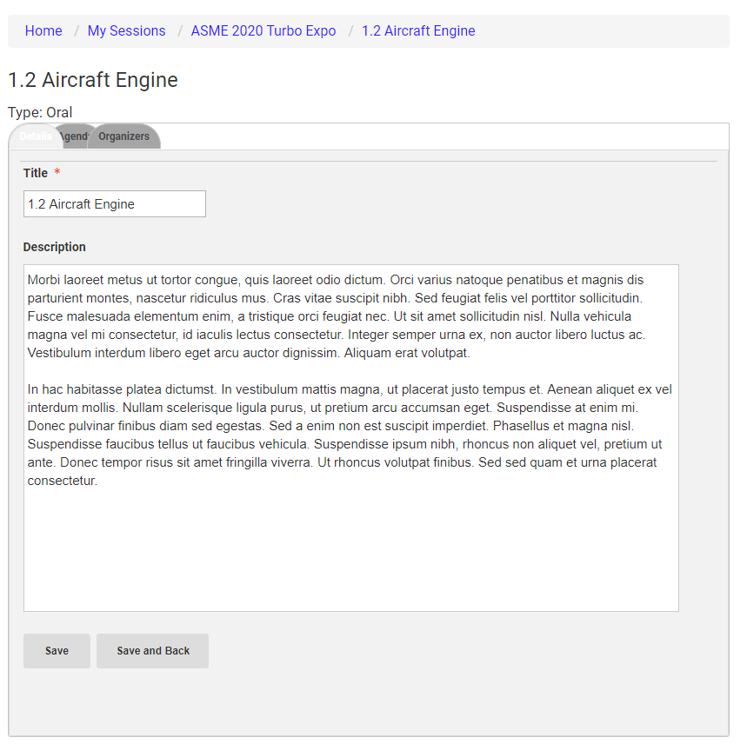
The first tab will let you adjust the session title and enter the session description.
DO NOT CHANGE NUMBERING

Slide 8
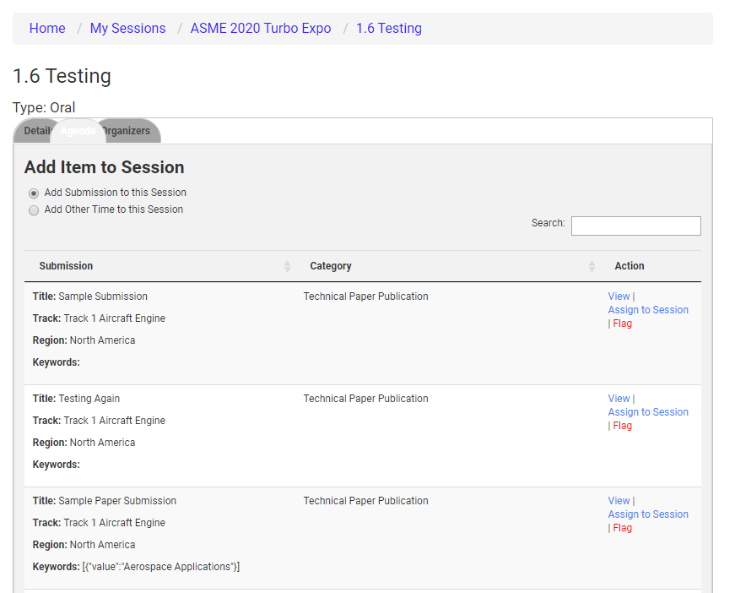
The Agenda tab is where you will start assigning submissions to the session.
Click on “View” to view the submission details.
Click on “Assign to Session” to move the submission into the session.
Click on “Flag” if the you feel that the submission should be assigned to another track. Staff will then re-assign as needed. You will be able to re-assign abstracts within your own track.

Slide 9
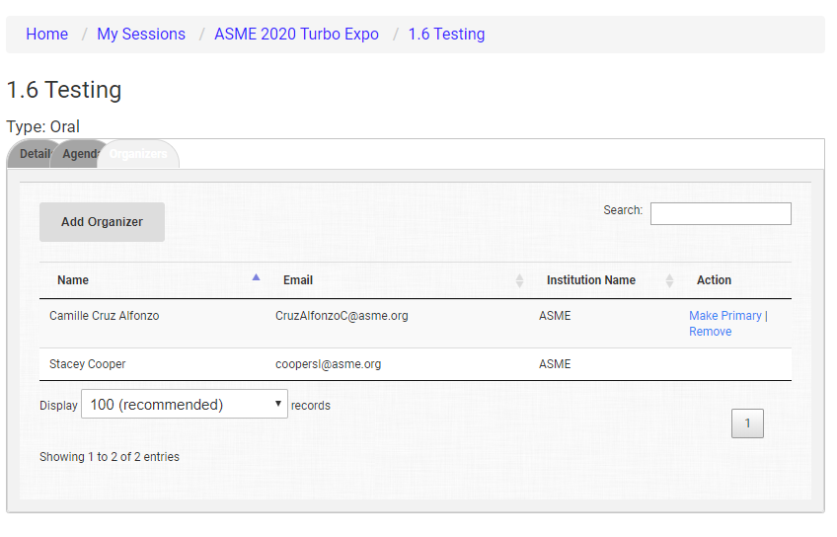
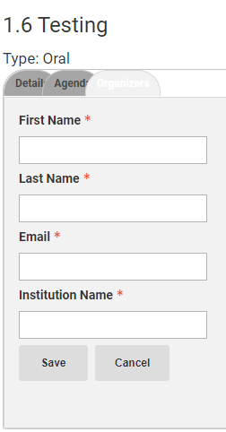
Click on the “Organizer” tab to assign your session organizers/chairs.
You are only required to enter their name, email, and company.
Click on “Make Primary” to assign the lead organizer/chair.

Slide 10
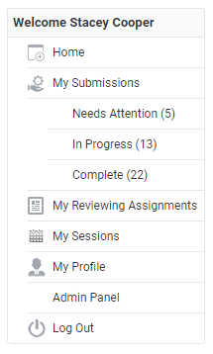
Click on “Organizer Tools” to begin the draft paper review process.

Slide 11
Click on “List Papers” to view the papers awaiting review.

Slide 12
The next screen will list all papers awaiting review.
The review status is displayed for each paper.
Click on “Manage” to assign reviewers to the paper.
Click on Invite Reviewers to invite a reviewer who is not in the database.

Slide 13
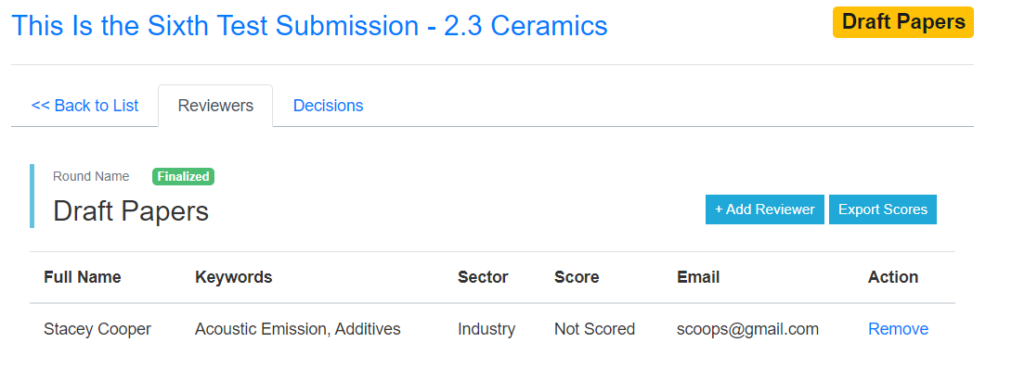
The next screen will display the paper title, session, and list of reviewers assigned
Click on “Add Reviewer” to assign a reviewer to the paper.

Slide 14
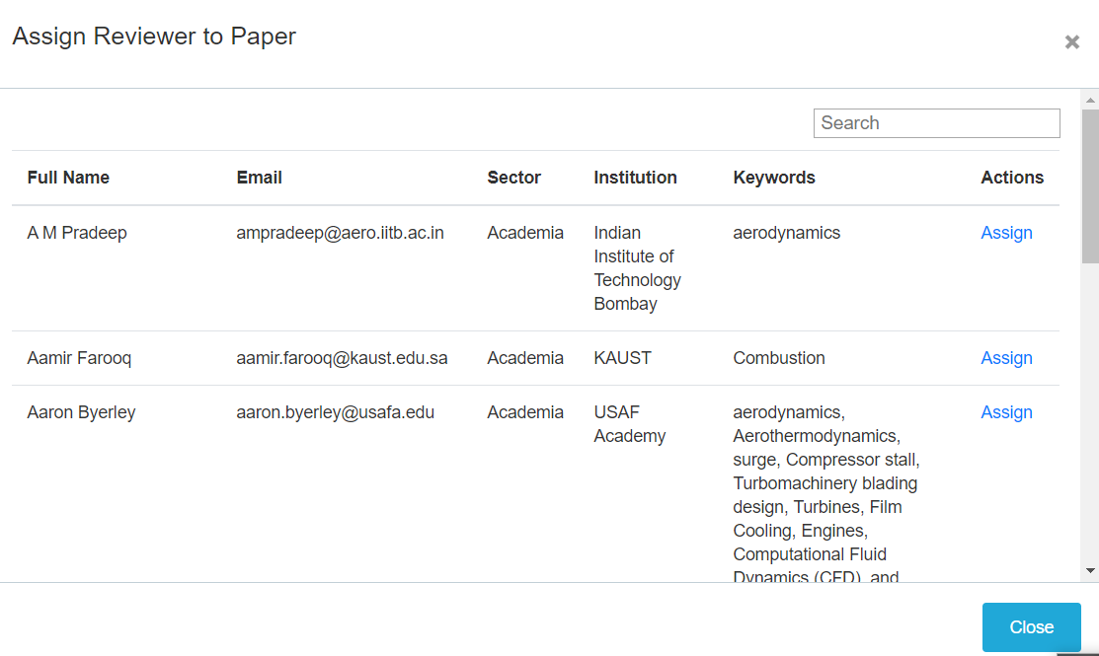
Select a reviewer from the available list.
If you do not see the reviewer in the list a URL will be provided so that the organizer can send the opt-in email for the reviewer database.

Slide 15
Draft Paper Review
Click on “My Reviewing Assignments” to begin the draft paper review process.

Slide 16
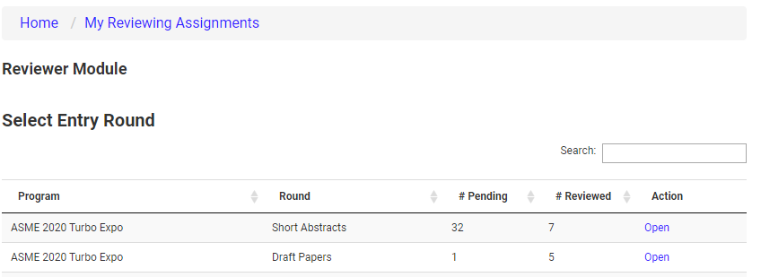
Click on the “Open” to start the paper review process.

Slide 17
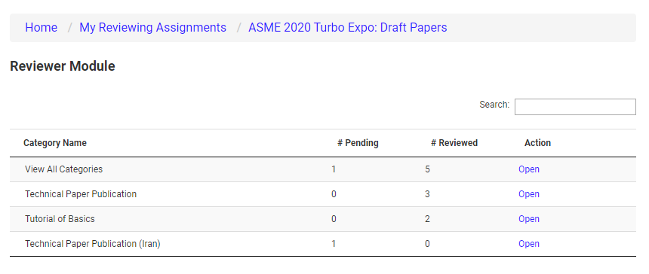
Reviewers can filter by paper type for the review.
Click on “Open” to start the draft paper review process.

Slide 18
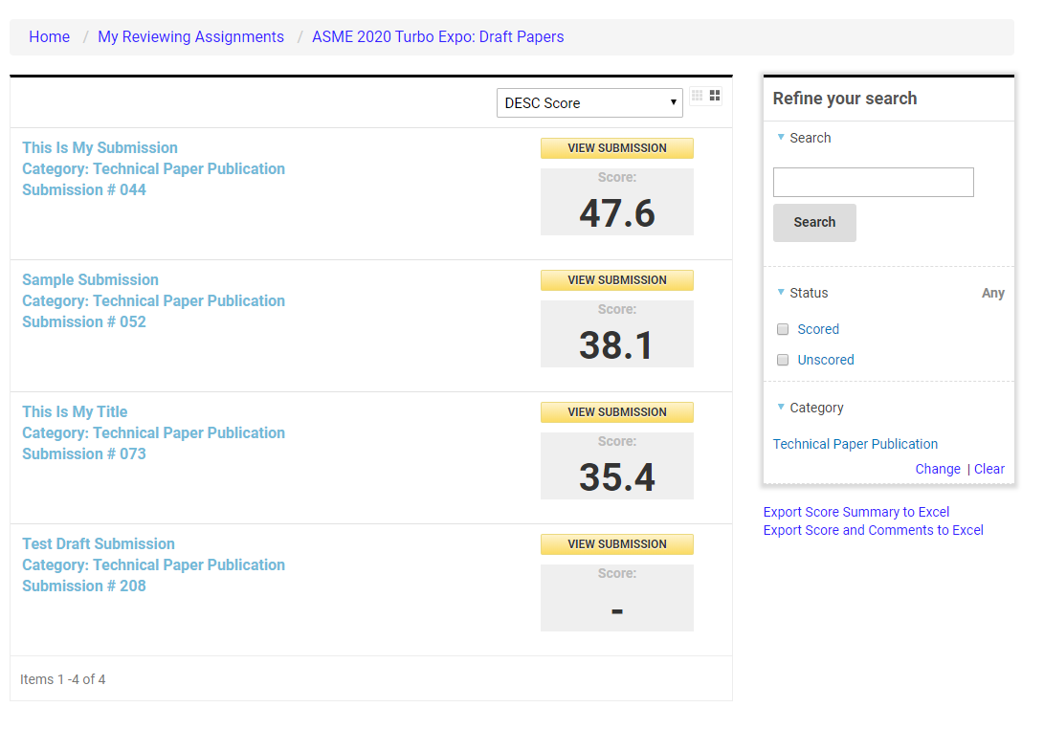
A list of papers that have been reviewed and those that are awaiting review will be displayed.
Users can filter by scored and unscored, filter by paper type, or search for a specific submission.
Click on the paper title or “View Submission” to start the review.

Slide 19
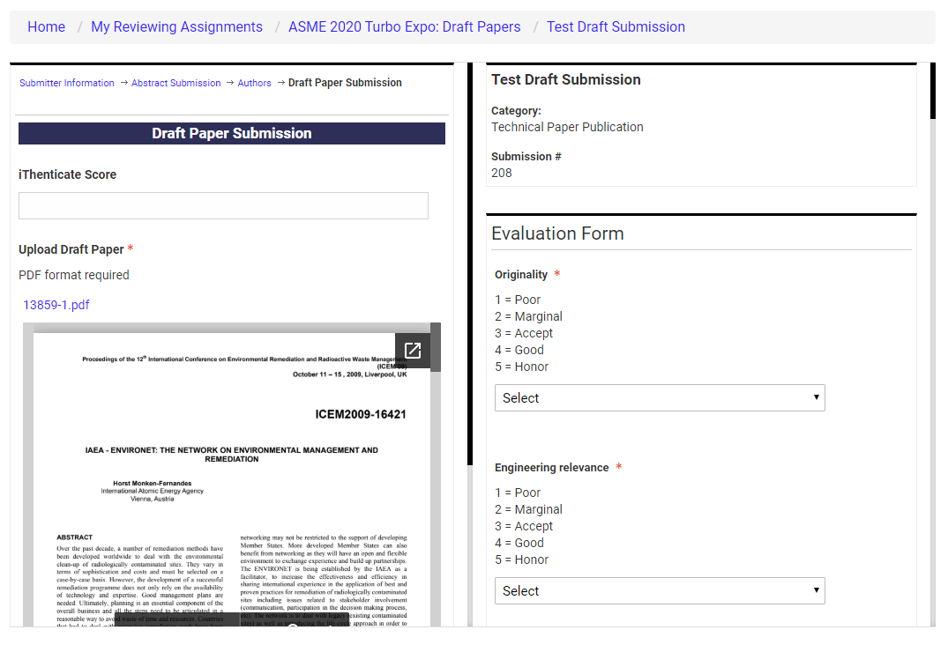
Reviewers can see the iThenticate score and match link, download the PDF file, and easily view the paper on your desktop.
The system will automatically save your comments so that you can leave and come back at any time.
Click on “Save and Back to List” to submit the review.

Slide 20
Make a Decision on Draft Papers and Revised Draft Papers
Go back to Organizers Tools > Click on List Papers.
Click on “View Comments” to access the reviewer comments on the screen.
Or click on “Export Scores” to download a report with all the reviewer comments. (You may experience some errors viewing this report as developers are still working on this feature.)

Slide 21
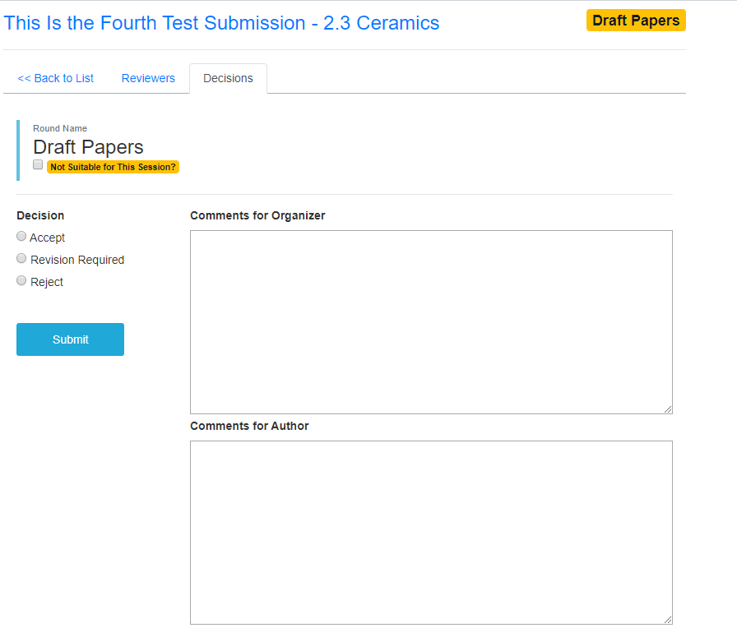
To make a decision on the paper, enter the comments for the organizer and author.
Make your selection if Accept, Revision Required, or Reject.
Options for Best Paper and Journal Quality will also be available
Notifications to authors will be sent on a rolling basis.

Slide 22
Questions/Help?
Please contact toolboxhelp@asme.orgwith any questions.
Join us for our twice-weekly help center calls on Tuesdays and Thursdays. Info on the website.

